Slide 1
www.TheRestorationMovement.com

Slide 2
Restoration: Unity & Division (1832–1900)
www.TheRestorationMovement.com

Slide 3
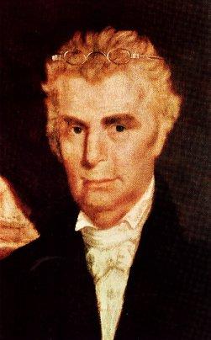
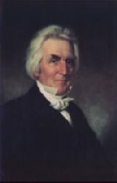
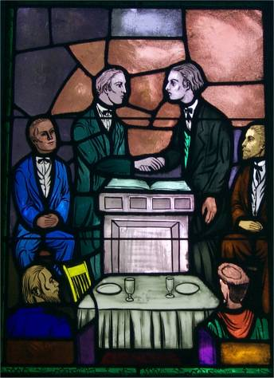
Growth And Departures
Christians & Disciples Come Together January, 1832

Slide 4
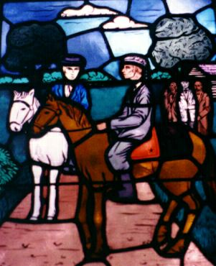
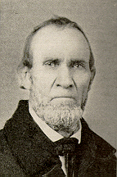
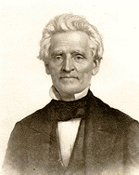
The Good New Spreads
During The Years 1832 & 1833 John Rogers & Raccoon John Smith Were Selected To Travel Throughout The Region To Make People Aware That Union Had Taken Place

Slide 5
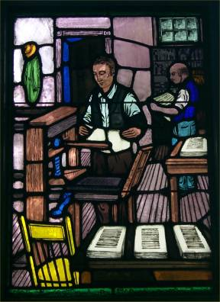
The Printing Press Contributed To Union
B.W. Stone’s Christian Messenger 1826 & A. Campbell’s Christian Baptist 1823, Distributed The Message Of Union Among Christians, Later Others Like Firm Foundation & Gospel Advocate Continued The Unity Call
12.1835, A.C.’s Millennial Harbinger listed 10 RM papers.

Slide 6
Some Highlights Over The Next Few Years
In 1835 The “Disciple’s Hymn Book” Is Distributed Bearing The Names Of B.W. Stone, Alexander Campbell, Walter Scott & John T. Johnson
1836 – A. Campbell publishes The Christian System
1836 – Bacon College Begins With Walter Scott As First President (Seeds of University Of Kentucky – 1858)
1841 – Bethany College Begins
1844 – Nov. 9, B.W. Stone Dies In Hannibal, Missouri

Slide 7
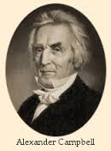
Missions Controversy
The Cooperation Meeting.
1831-1832 Campbell pub. series of 7 articles in Millennial Harbinger on “The Cooperation of Churches.”
Believed world would never be evangelized unless churches cooperated in some way.
The 7 articles were a plea for cooperation, but NOT organization, believing churches could work together without societies.
Some disagreed with any kind of cooperation, that it would lead to organization, like presidents, treasurers and secretaries, etc.
1788-1866

Slide 8
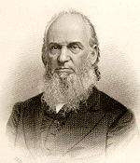
The Bible Society
1845 - 1st brotherhood organization — American Christian Bible Society, Cincinnati, Ohio
D. S. Burnet, Cincinnati, took lead.
Purpose: “to aid in the distribution of the Sacred Scriptures” throughout the world. -(Christian Review – 1845, page 80)
Constitution (Burnet) called for officers, an annual meeting, and auxiliary societies.
Burnet, the president, called it a “holy cause” which should “enlist all our affections.”
D. S. Burnet
(1808-1867)

Slide 9
The Missionary Society
Bible Society got support from most periodicals, but Campbell opposed it in the MH.
Reason: Was organized by a few Cincinnati brethren rather than a general convention.
Arthur Crihfield later said that if it “had commenced at Bethany,” Campbell would not have opposed.
There was controversy among periodicals.
Campbell and Burnett were friends, but Campbell did not relent in opposition.
1788-1866

Slide 10
American Christian Missionary Society
1849 Campbell renewed efforts to persuade brotherhood of need for “a more efficient organization.”
Obviously serious problems in proposal.
How could independent churches hold a convention?
Who could call it?
Where would it be held?
Would the brotherhood accept it?
1788-1866

Slide 11
American Christian Missionary Society

Slide 12
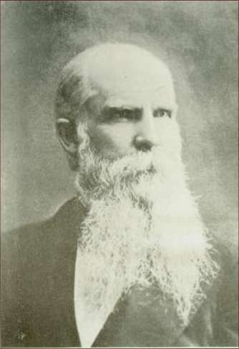
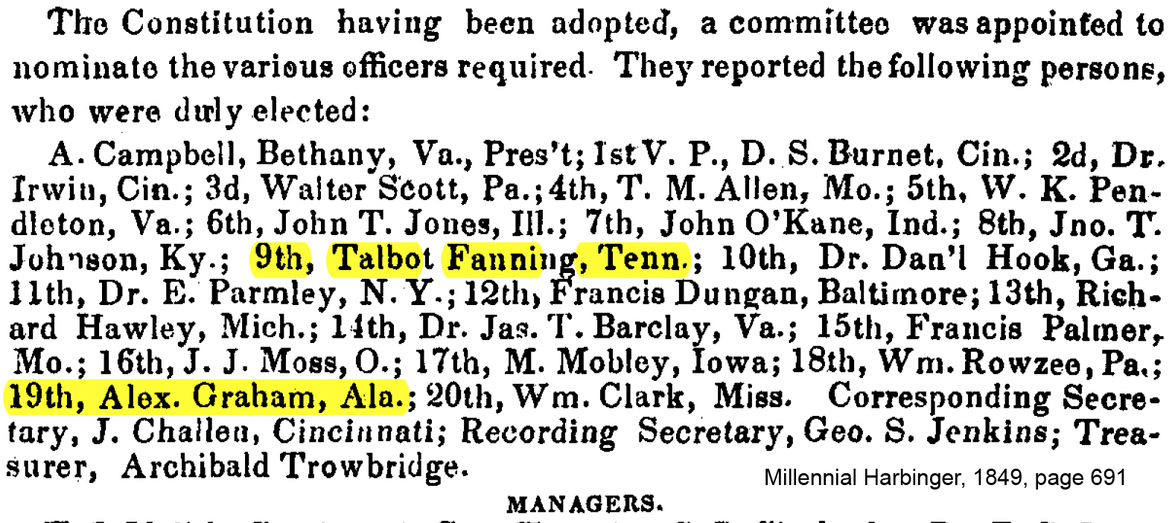
ACMS
W.K. Pendleton 1817-1899

Slide 13
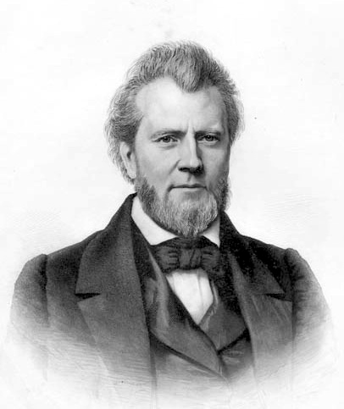
The First Work Of The ACMS
1st work of society--sent Dr. James T. Barclay, Scottsville, VA, to Jerusalem.
Barclays arrived in 1850.
Alexander Cross, freed slave, to Liberia, and J. O. Beardslee to Jamaica.
J.T. Barclay 1807-1874

Slide 14
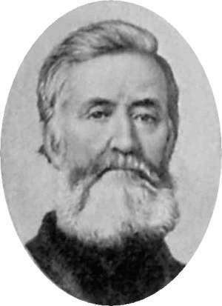
Reaction To ACMS Came Quickly
Followed by a decade of opposition.
ACMS never had support of all brotherhood.
Jacob Creath, Jr. the most outspoken early critic.
Campbell in 1823 in CB had said NT churches “were not fractured into missionary societies.” -The Christian Baptist, “The Christian Religion,” 1823, page 14.
Campbell said, “They (NT Church) knew nothing of the hobbies of modern times.”ibid.
Jacob Creath, Jr.
(1799-1886)

Slide 15
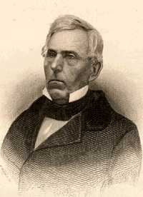
Tolbert Fanning’s Reaction
Tolbert Fanning 1810-1874

Slide 16
ACMS – Continual Development
1869 – Attempts to reorganize in Louisville, Ky. “Louisville Plan”
Delegates elected from local churches to serve at district meetings
Delegates elected at district meetings to serve at state society.
Money followed a similar structure from local to state to national support.
District kept half the money, sent rest to state
State kept half the money, sent rest to national
Result: Little money made it to national level. After salaries paid, no money left for missions.
By 1872 Louisville Plan was seen as a failure.

Slide 17
Further Mission Organization
1874 – Christian Women’s Board Of Missions
1875 – Foreign Christian Missionary Society
1919 – These along with the ACMS merged into one body: The United Christian Missionary Society

Slide 18
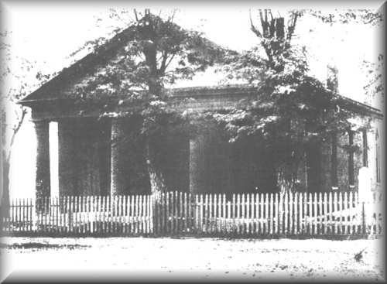
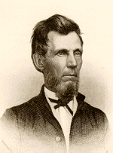
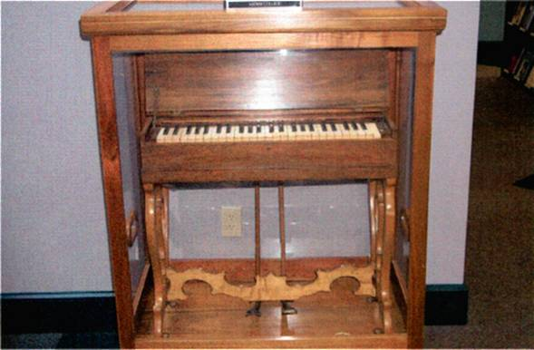
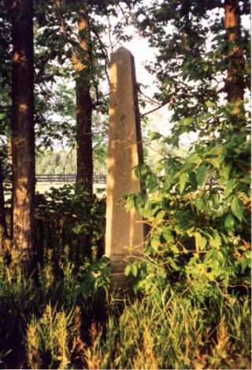
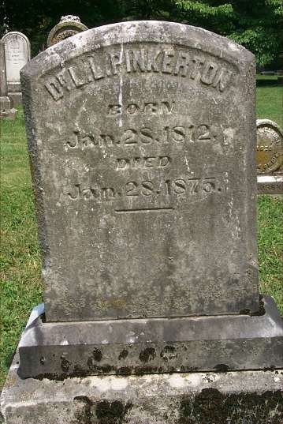
The Incident At Midway, Kentucky
Adam Hibler Grave
L.L. Pinkerton Grave

Slide 19
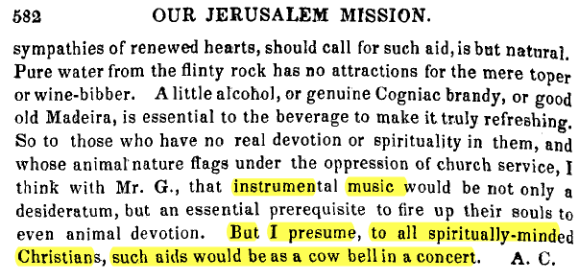
Early Controversy Over Music
A. Campbell expressed his opposition to IM in Millennial Harbinger, October, 1851

Slide 20
Benjamin Franklin’s Opposition
Benj. Franklin 1812-1878
American Christian Review
In Vol. III, #5, Jan. 31, 1860 page 19, stated that those who use instrumental music in worship never had or had lost the Spirit Of Christ. “Instrumental Music in Churches”
Feb. 28th – Followed up with another stinging article called “Instrumental Music In Churches.”

Slide 21
Controversy Over Music
Three groups developed in the years that followed Midway
Supporters of ACMS and IM – prompted the founding of the Christian Standard in 1866 by Isaac Errett (Cincinnati, OH)
Supporters of ACMS but against IM – J.W. McGarvey & Moses Lard (Apostolic Times, beg. 1869) (Lexington, KY)
Supporters of Neither ACMS or IM – Tolbert Fanning, David Lipscomb, (Gospel Advocate) (Nashville, TN) Benjamin Franklin (American Christian Review) (Anderson, IN)

Slide 22
March, 1864 Lard’s Quarterly
Moses E. Lard 1818-1880

Slide 23
1881, Apostolic Times
J.W. McGarvey 1829-1911
-Instrumental Music in the Worship OR THE GREEK VERB PSALLO PHILOLOGICALLY AND HISTORICALLY EXAMINED M.C. Kurfees, p.234 (In Apostolic Times, 1881, and "What Shall We Do About the Organ?" pp. 4, 10.

Slide 24
Prevalence Of IM Use
1868 Ben Franklin hazarded the guess that there were ten thousand congregations in the brotherhood, and not over fifty of them had used the instrument in worship.” –Benjamin Franklin, as quoted by Earl West, Search For The Ancient Order, Vol. 2, page 80,81.
1878 – David Lipscomb wrote, “Those who introduce instrumental music give up the heart worship of Christ for the formalism of Judaism.” -Gospel Advocate, 1878, pgs. 457-458
Benj. Franklin 1812-1878
David Lipscomb 1831-1917

Slide 25
“The Cathedral” 1872 Central Christian, Cincinnati, Ohio

Slide 26
The Church During The Civil War
War began April 12, 1861
During War Many Lost Their Faith
Many Enlisted In The Military, Preachers Became Chaplains
Many Journals Ceased Publication incl. GA
October, 1861 – Biggest Wedge Was When The Missionary Society Condemned The South, Southern Brethren Were Appalled

Slide 27
After The Civil War
Many Issues That Were Before The War Started Up Again
Alexander Campbell Died March 4, 1866
The Gospel Advocate Restarted In 1866 With Tolbert Fanning And A Young David Lipscomb As Co-Editors
Over The Next 40 Years The Society And Instrument Continue To Destroy Unity.
In The 1906 U.S. Census The Church of Christ And The Christian Church Was Recognized As Different Entities

Slide 28
Theological Liberalism
1869 – L.L. Pinkerton started the Christian Monthly, in which he denounced plenary verbal inspiration of the Bible
1889 – Dr. R.C. Cave of St. Louis, dropped a bombshell in a sermon when he denounced both the virgin birth and the bodily resurrection of Christ.
1889 – J.S. Lamar wrote of his favor to accept the unimmersed into fellowship of the church.
L.L. Pinkerton 1812-1875
Robert C. Cave 1843-1923

Slide 29
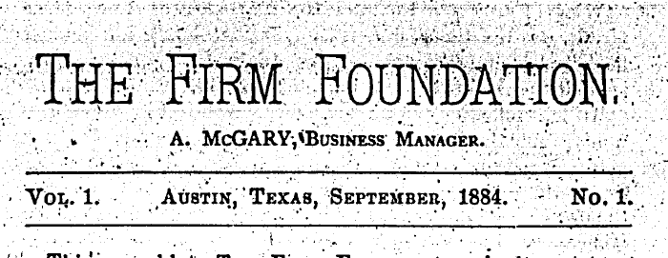
The Firm Foundation - 1884
Austin McGary 1846-1928
Austin McGary, Texas preacher begins the The Firm Foundation magazine to attack prevalence among some to accept into fellowship those immersed for any cause and from denominations.
In his first issue he attacked the writings of T.R. Burnett & John T. Poe
2nd Issue his crosshairs were on David Lipscomb and The Gospel Advocate
T.R. Burnett 1837-1916
John T. Poe 1836-1917
David Lipscomb 1831-1917

Slide 30
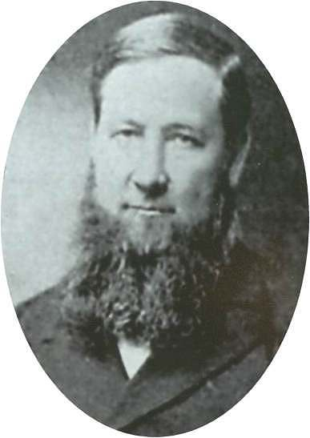
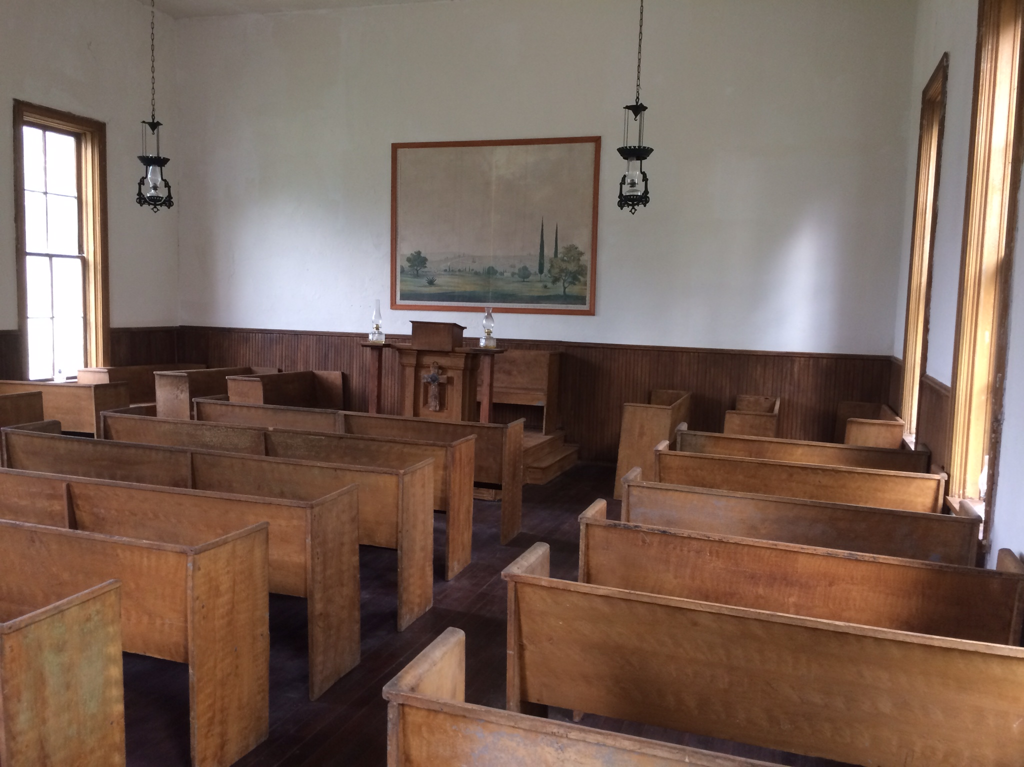
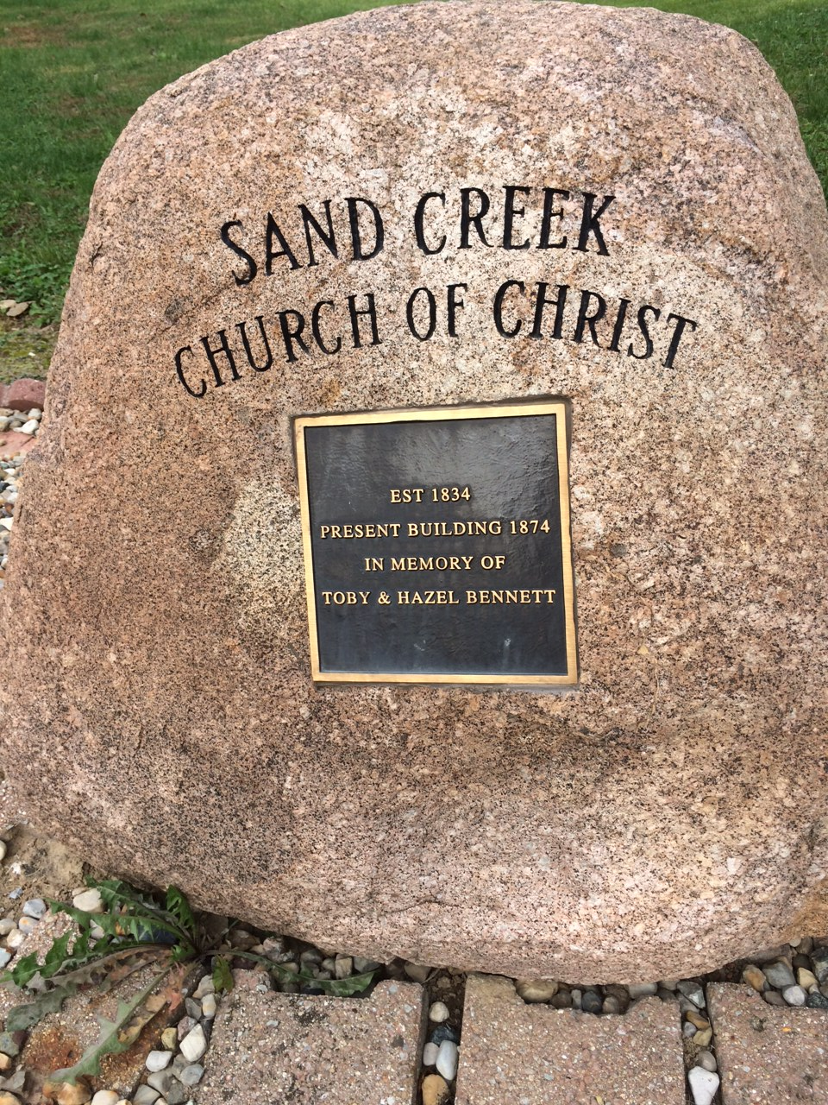
Sand Creek Meeting
August 18, 1889, Shelby County, Illinois
Daniel Sommer 1850-1940

Slide 31
Breakdown Of Movement
Class | Conservatives | Liberals
Religious Authority | Faith/Testimony | Opinion/Inference
Church Government | Plurality Of Bishops | One-Man Pastorate
Preaching The Gospel | Through The Church | Through Missionary Society
Finances | Giving Through Simplicity | Fairs, Festivals & Begging
Music | Congregational Singing | Instrumental Music
Character of Members | Poor, pious, simple, humble, peace-loving, honest | Rich, shameless, arrogant, divisive, “usurpers of other men’s labors”

Slide 32
Seven Signs That Brought Separation
Tears Shed By Loyal Christians
Angry and unchristian words and actions from liberals
Strifes and alienations
Divisions
Lost opportunities to save souls
Expenditures of time, money and strength
Feuds, “heartburning and heartbreaking”

